Slide 1
Module 1: Introduction and Overview of Graphics System
By Poonam Pangarkar
Department of CSE Data Science APSIT

Slide 2
Topics
Definition of computer graphics
Representative uses of computer graphics

Slide 3
Definitions
The computer graphics is one of the most effective and commonly used way to communicate the processed information to the user. It displays the information in the form of graphics objects such as pictures, charts, graphs and diagrams instead of simple text.
The Computer Graphics is rendering (Service) tool for generation of images and manipulation of images.
Computer graphics is the technology that deals with designs and pictures on computers, which studies about manipulating visual content, Synthesizing digitally.

Slide 4
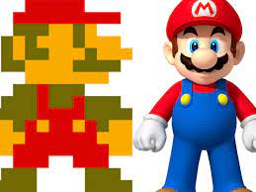
Definitions
Computer graphics started with the display of data on hard copy plotters and cathode ray tube (CRT).
It has grown to include the creation, storage, and manipulation of models and images of objects.
Today’s computers are capable of generating lifelike images that are virtually indistinguishable from the images captured in photographs.

Slide 5
Representative Uses
User interfaces : GUI, etc.
Business, science and technology: histograms, bar and pie charts, etc.
Office automation and electronic publishing : text , tables, graphs, hypermedia systems, etc.
Computer-aided design (CAD): structures of building, automobile bodies, etc.
Simulation and animation for scientific visualization and entertainment: flight simulation, games, movies, virtual reality, etc.
Art and commerce : terminals in public places such as museums, etc.
Cartography : map making

Slide 6
Overview of Coordinate System in Computer Graphics

Slide 7
Topic
Overview of coordinate system
Cartesian
Polar
World
Others

Slide 8
Coordinate Systems
Basically 2D sites are divided in two basic coordinate systems:
Cartesian Coordinate
Polar Coordinate
Cartesian coordinate system is used by most of the graphics package. Basically Cartesian Coordinate system specifies each point uniquely in a plane by a pair of numerical coordinates.
In polar Coordinate, system is specified with a radial distance r from the coordinate origin and an angular displacement from the horizontal. The angle is measured in degree

Slide 9
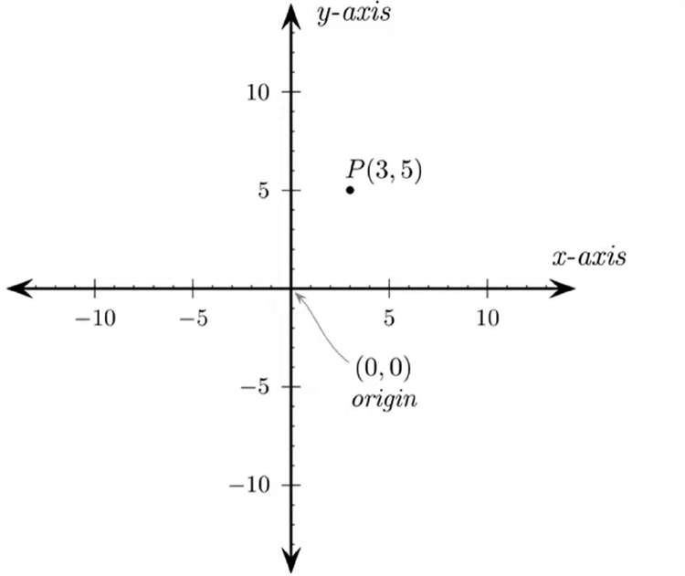
Cartesian Coordinate System

Slide 10
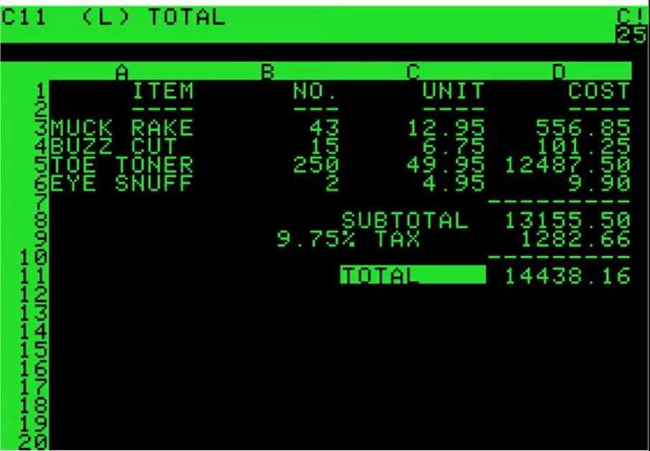
Basic Graphics (history) - 2D Plane

Slide 11
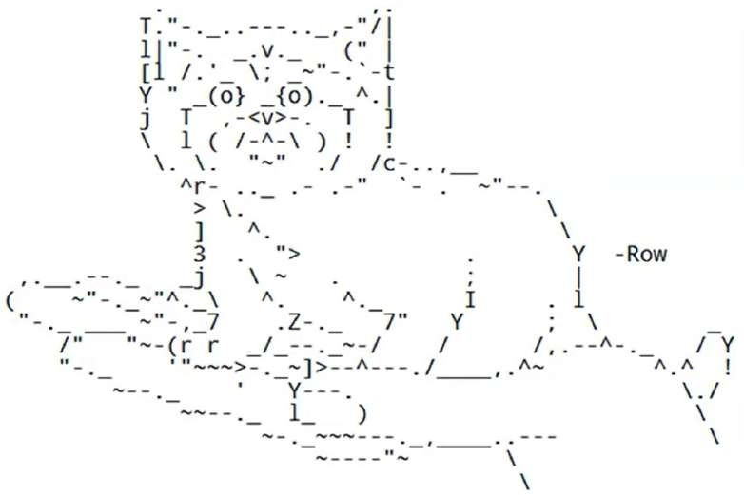
Art in 2D Plane

Slide 12
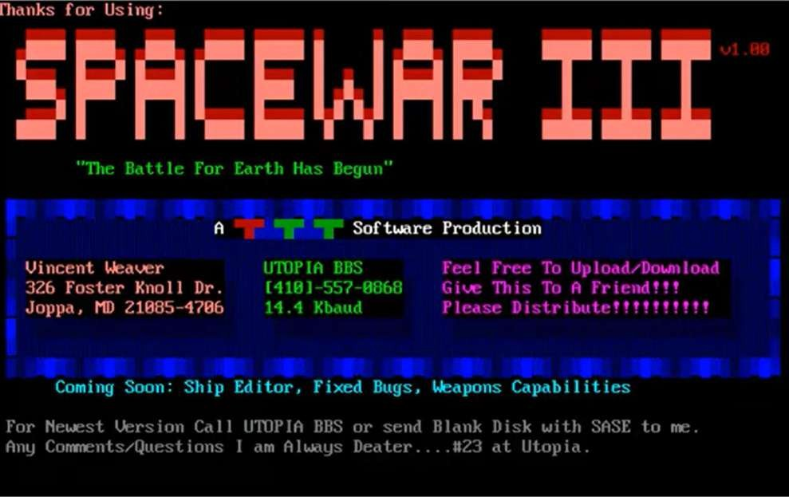
Advancements in 2D Plane

Slide 13
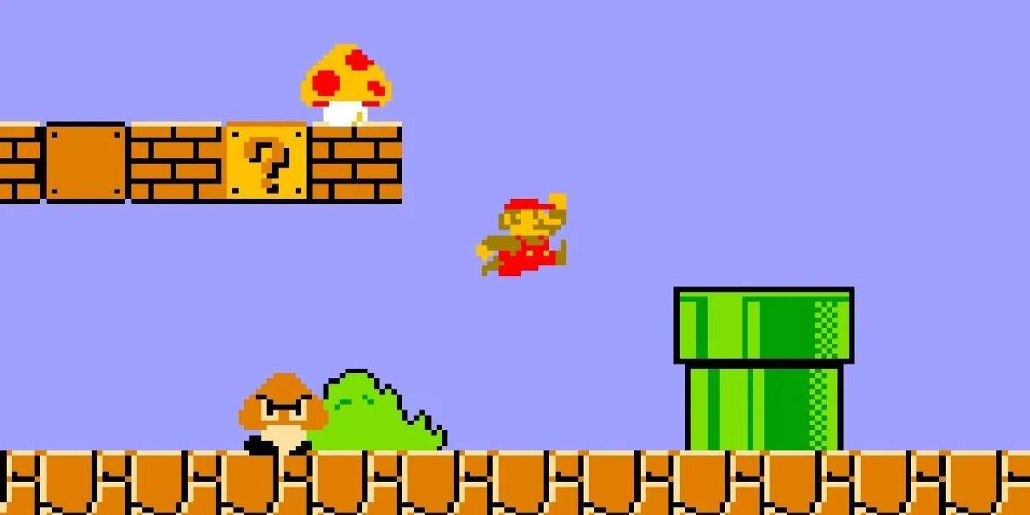
Advancements in 2D Plane

Slide 14
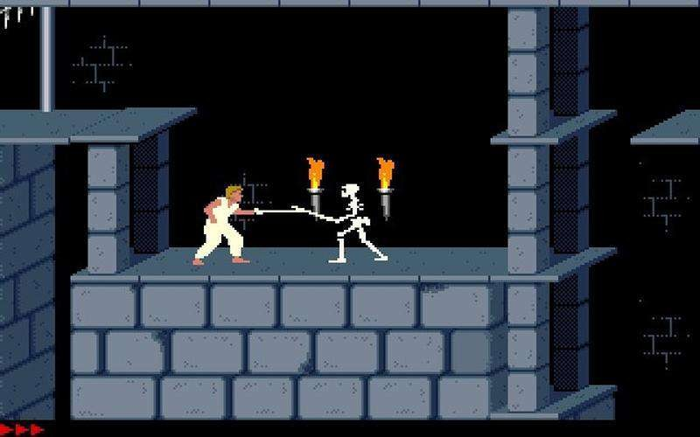
Advancements in 2D Plane

Slide 15
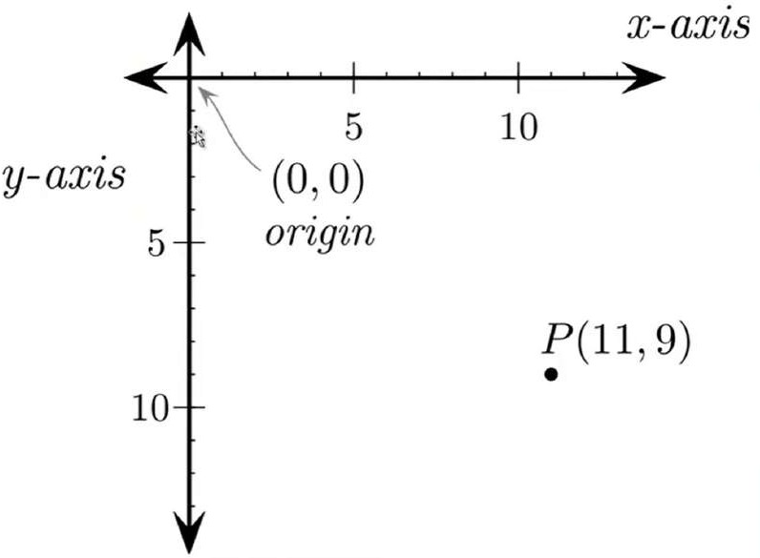
How Coordinate System was designed before
Length of Axis will increase to hold more resolution

Slide 16
Polar Coordinate Systems
In polar Coordinate, system is specified with a radial distance r from the coordinate origin and an angular displacement from the horizontal. The angle is measured in degree.

Slide 17
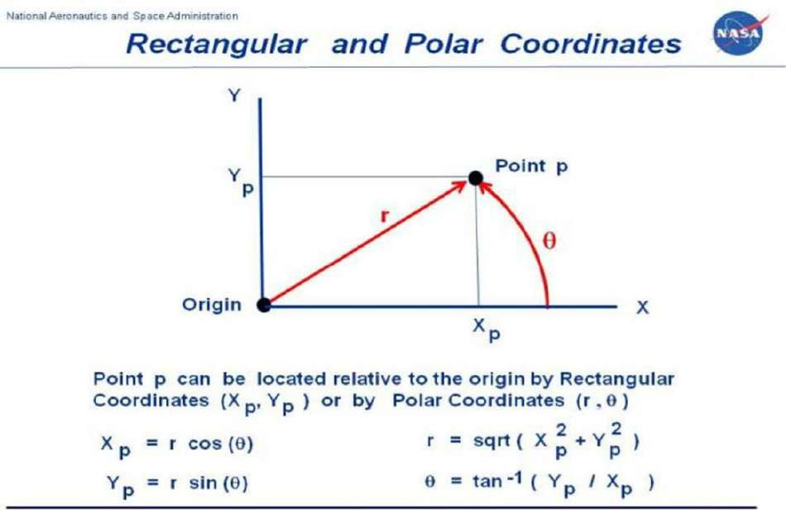
Polar Coordinate System

Slide 18
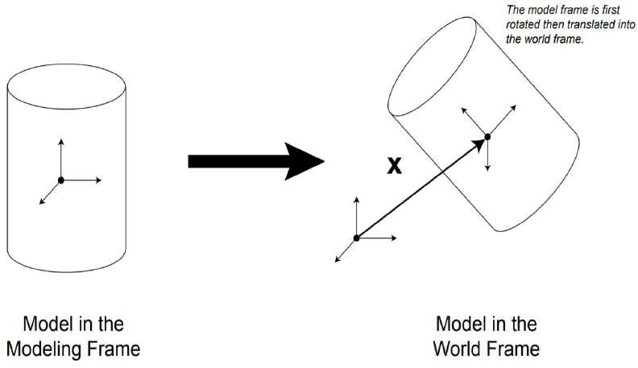
World Coordinate System
Also known as the "universe" or sometimes "model" coordinate system. This is the base reference system for the overall model, (generally in 3D), to which all other model coordinates relate.
The coordinate system in which a scene is defined. The image that is produced of the scene will show the contents of the world coordinate system that lie within some some view volume (for 3D) or view window (for 2D). Objects are defined in their own object coordinate system. Modeling transformations are then applied to place objects into the scene; that is, they transform object coordinates to world coordinates.

Slide 19
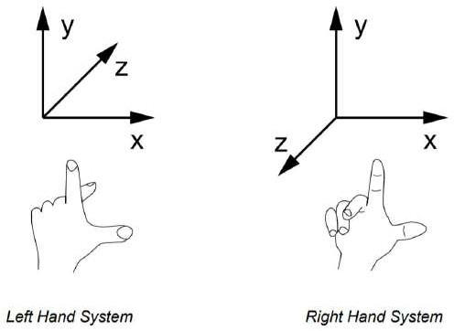
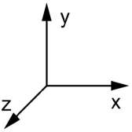
Right Handed and Left Handed Coordinate System
A 3D coordinate frame might be drawn as shown in the diagram to the right. The three axes are understood to be at right angles (orthogonal) to each other. In the figure, x denotes the horizontal axis, y the vertical axis, and z the depth axis (coming out of the page). This the usual r ight- handed coordinate system seen in Computer Graphics.
The coordinate system shown above is called right handed, since if you place your thumb, index finger and the middle finger of the right hand at right angles to each other, as demonstrated in the above figure, they look like coordinate axes. The thumb represents the x axis, the index finger represents the y axis, and the middle finger represents the z axis. As can be seen from the figure, when done with the left hand, the z axis, is reversed, measuring depth into the page.

Slide 20
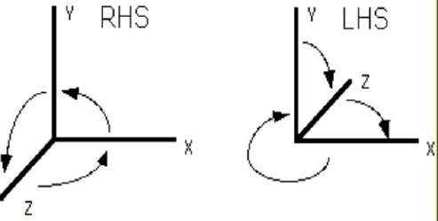
Right Handed and Left Handed Coordinate System
Right Hand Coordinate System (RHS)
Z is coming out of the page Counterclockwise rotations are positive
if we rotate about the X axis : the rotation Y->Z is positive if we rotate about the Y axis : the rotation Z->X is positive if we rotate about the Z axis : the rotation X->Y is positive
Left Hand Coordinate System (LHS)
Z is going into the page
C l o c k w i s e r o t a t i o n s a r e p o s i t i v e if we rotate about the X axis : the rotation Y->Z is positive if we rotate about the Y axis : the rotation Z->X is positive if we rotate about the Z axis : the rotation X->Y is positive

Slide 21
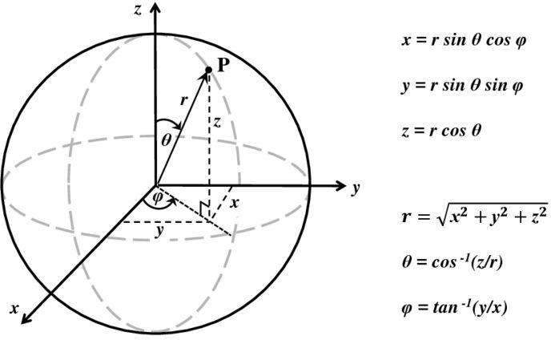
Spherical Coordinate System

Slide 22
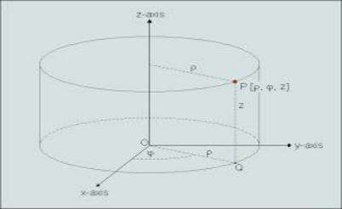
Cylindrical Coordinate System

Slide 23
Other Coordinate Systems
Object Coordinate System - When each object is created in a modelling program, the modeller must pick some point to be the origin of that particular object, and the orientation of the object to a set of model axes.
For example when modelling a desk, the modeller might choose a point in the center of the desktop for the origin, or the point in the center of the desk at floor level, or the bottom of one of the legs of the desk. When this object is moved to a point in the world coordinate system, it is really the origin of the object ( in object coordinate system ) that is moved to the new world coordinates, and all other points in the model are moved by an equal amount. Note that while the origin of the object model is usually somewhere on the model itself, it does not have to be. For example, the origin of a doughnut or a tire might be in the vacant space in the middle.
Hierarchical Coordinate Systems - Sometimes objects in a scene are arranged in a hierarchy, so that the "position" of one object in the hierarchy is relative to its parent in the hierarchy scheme, rather than to the world coordinate system. For example, a hand may be positioned relative to an arm, and the arm relative to the torso. When the arm moves, the hand moves with it, and when the torso moves, all three objects move together.

Slide 24
Other Coordinate Systems
Viewpoint Coordinate System - Also known as the "camera" coordinate system. This coordinate system is based upon the viewpoint of the observer, and changes as they change their view. Moving an object "forward" in this coordinate system moves it along the direction that the viewer happens to be looking at the time.
Model Window Coordinate System - Not to be confused with desktop windowing systems ( MS Windows or X Windows ), this coordinate system refers to the subset of the overall model world that is to be displayed on the screen.
Screen Coordinate System - This 2D coordinate system refers to the physical coordinates of the pixels on the computer screen, based on current screen resolution. ( E.g. 1024x768 )
Viewport Coordinate System - This coordinate system refers to a subset of the screen space where the model window is to be displayed. Typically the viewport will occupy the entire screen window, or even the entire screen, but it is also possible to set up multiple smaller viewports within a single screen window.

Slide 25
Scan Conversions in Computer Graphics

Slide 26
Topics
Definition of scan conversion
Advantages of scan conversion
Objects
Pixel

Slide 27
Definition of scan conversion
The process of representing continuous graphics object as a collection of discrete pixels by identifying their locations and setting them On is known as scan conversion.
The process of deterring which pixels will provide the best approximation to the desired line is properly known as rasterization

Slide 28
Advantage of developing algorithms for scan conversion
Algorithms can generate graphics objects at a faster rate.
Using algorithms, memory can be used efficiently.
Algorithms can develop a higher level of graphical objects.
This scan conversion methodology is used for many purposes including TV, the card used to capture a video, LCD monitor, projectors used for video display any more.
This conversion technique has large and many applications in daily life.
One can efficiently perform this scan conversion using high and good speed circuits that are integrated.

Slide 29
Objects that can be SCAN converted
Point
Line
Sector
Arc
Ellipse
Rectangle
Polygon
Characters
Filled Regions

Slide 30
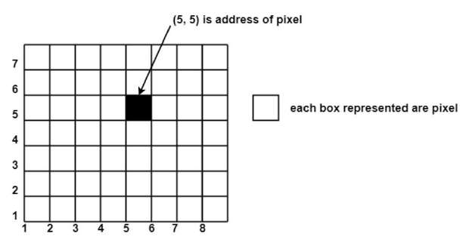
PIXEL
A pixel is the smallest unit of a graphics image or referred to as a physical point in a raster. This is the component of the original graphics image which provides even more clear representation than the original image.
The intensity of each pixel may vary as it depends on the image represented in the graphics image and the color combination is represented by the three basic colors that are red, green and blue.
“We can define a pixel as a rectangular dot centered at an integral position on an integral grid.” It is a real point that is addressable. The pixel is also called “picture element (Pel).”
A pixel includes its own:
Intensity – The intensity of a pixel defines the brightness of the image that appears on the screen.
Name or Address- The name or address of a pixel defines the position of the pixel.

